Slide 1
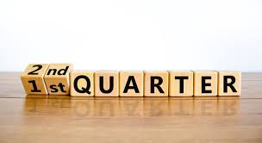
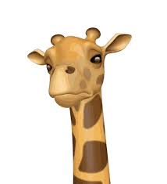

Ethan and Moises’ Quarter two project
Bidirectional Alpha-beta Neural Agent Network Algorithm with Self-training
(BANANAS)
1.17.2025
Yilmaz pd 6 ML1

Slide 2
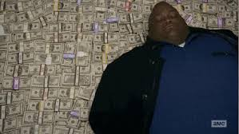
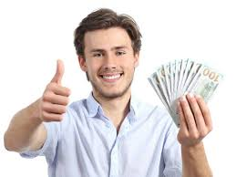
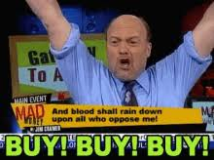

Some background
We want MONEY
Stock market is hard to model
Simulation takes inspiration from
Game theory games
We want to make a strategy that is best able to maximise its profit in this simulation
Simulation serves as a parallel to a real stock
market

Slide 3
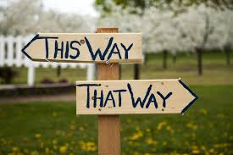
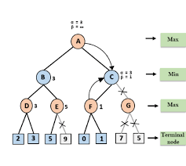
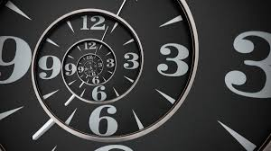
Introduction
Alternative solutions
RNNs, CNNs, RL, and Bayesian Networks
Fails to capture real-world competition
Time series predictions only
Long time horizon
Model inspired by old Othello heuristic algorithms

Slide 4
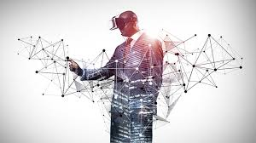
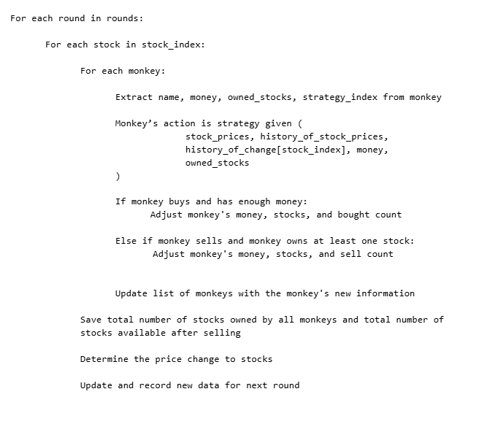
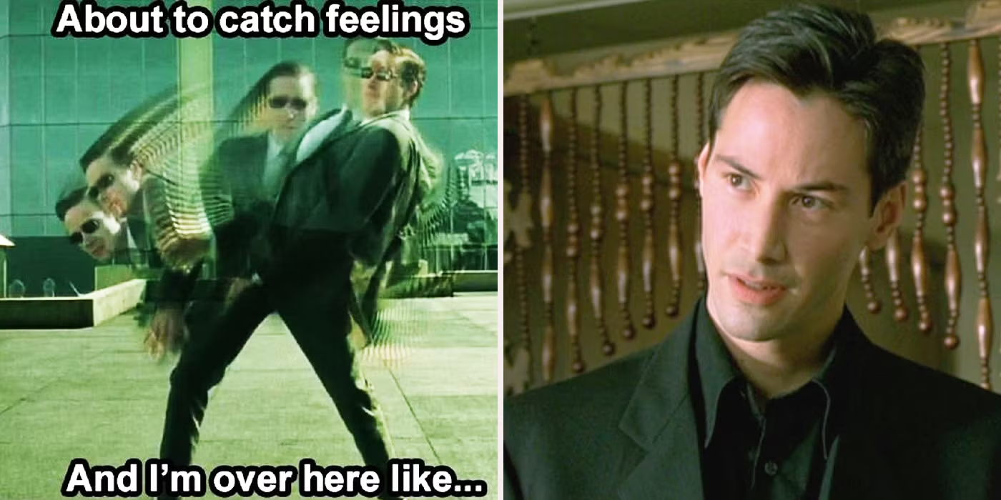
The simulation
Turn-based
Each monkey allowed one action(buy, sell, or hold) in a single round
Monkey’s action dependent on strategy given prices, price history, and monkey’s portfolio
Extra dimension to randomness

Slide 5
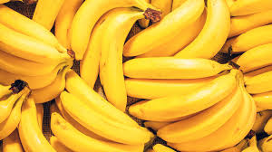
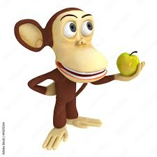
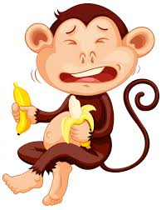
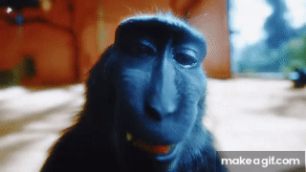
MONKEYS!!!

Slide 6
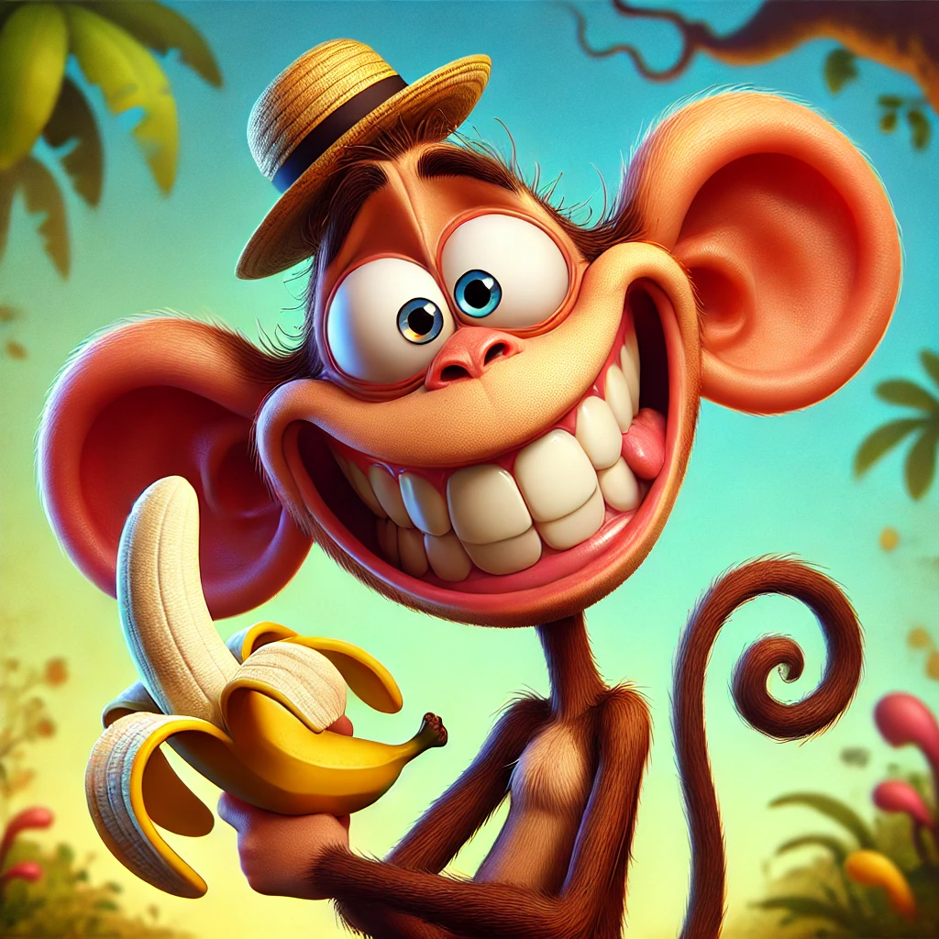
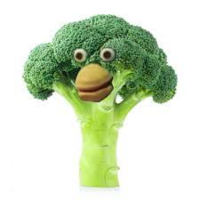
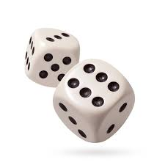
Random monkey
Moves at random
Control monkey
He is always happy

Slide 7
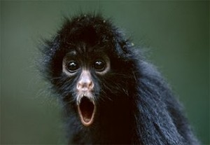
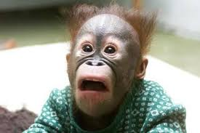
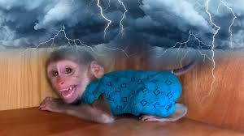
Scared monkey
Buys at the beginning of the simulation, sells all as soon as stock goes down
Panicking is always a good idea right?

Slide 8
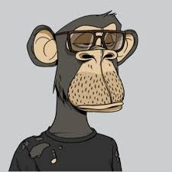
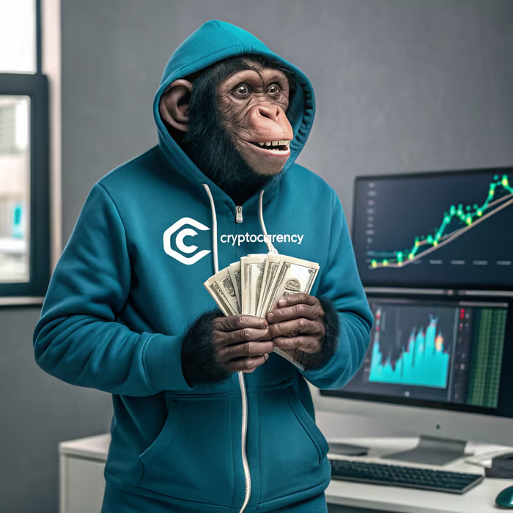
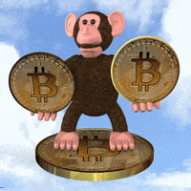
Crypto-Bro monkey
He OWNS THE MONEY
He sells at local max and
He tell other monkeys to sell and then he buy
He win

Slide 9
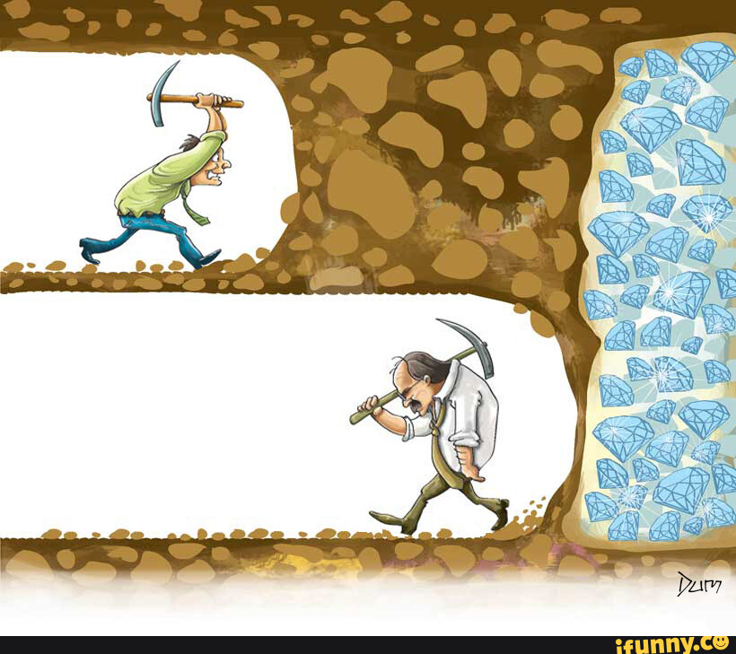
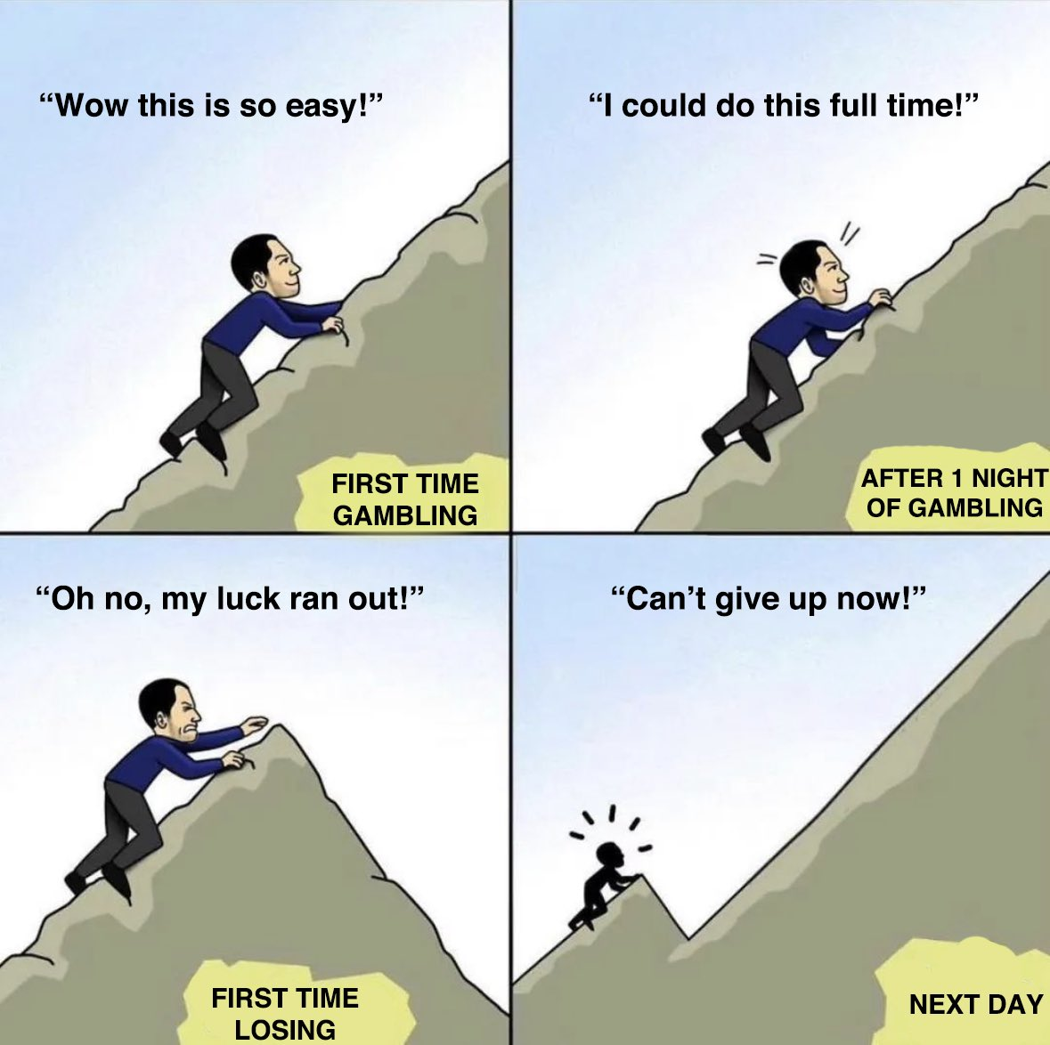

Hold Hold HOLD MONKEY
90% of stock traders sell before they win big
Monkey hold and never sell
Stock only go up

Slide 10
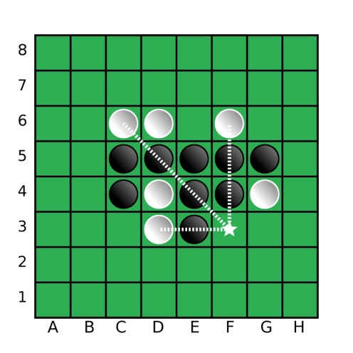
Prior research
Inspired by Othello research
Alpha beta pruning and a man made scoring function was the generally accepted strategy
Old implementation of neural networks failed due to lack of data and complexity of game
Combining alpha and beta and neural network might lead to more successful results

Slide 11
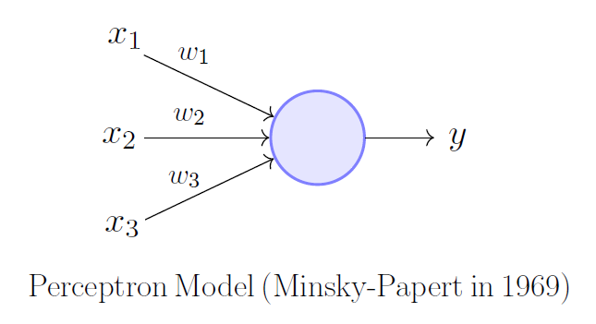
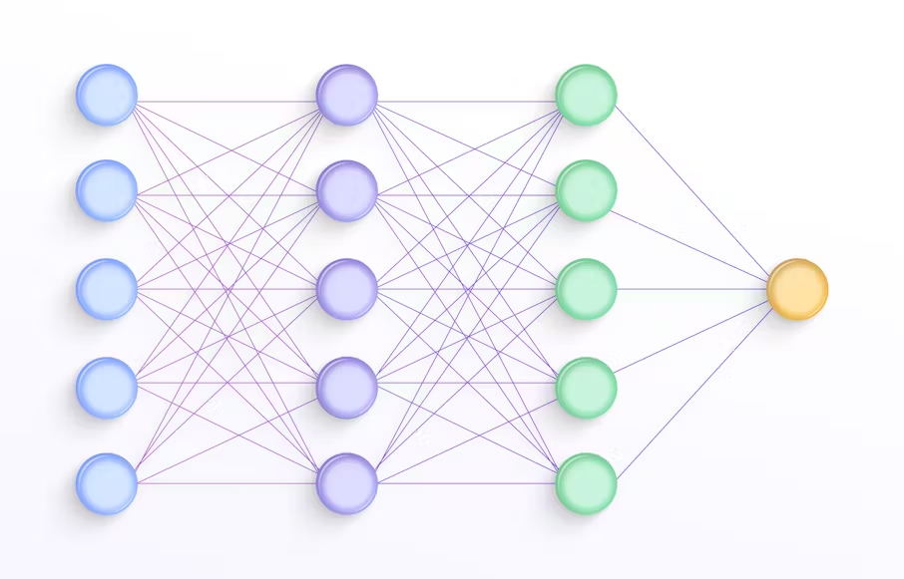
What is a neural network?
What is a perceptron?
It is a basic neuron that can add and multiply
A collection of perceptrons make a neural network
Good at finding patterns and evaluating them

Slide 12
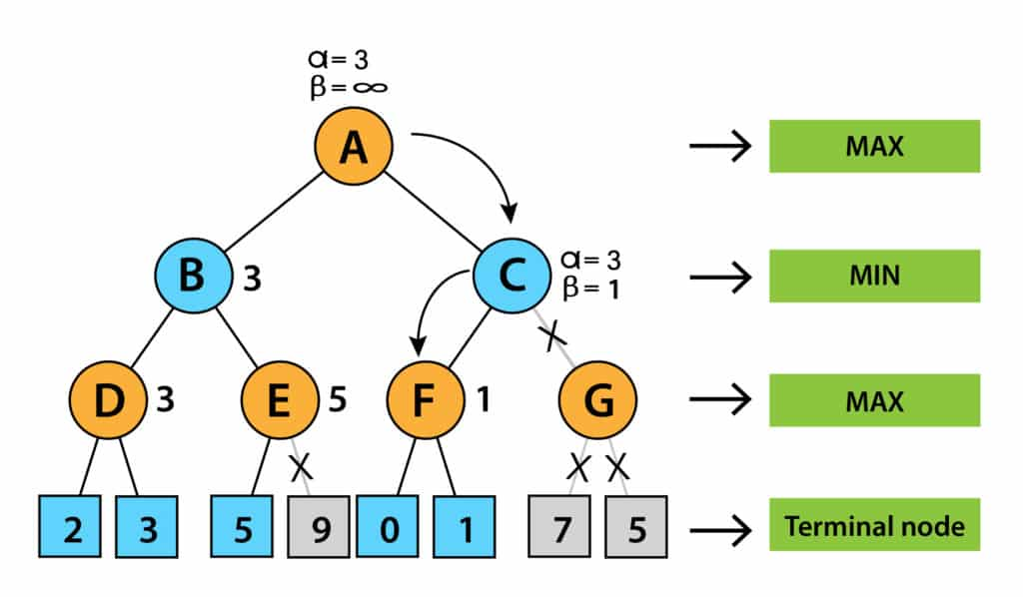
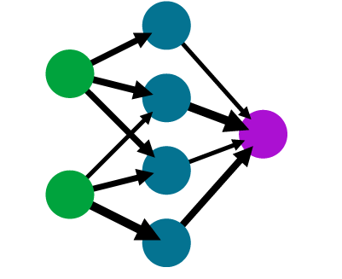
Understanding the algorithm
A mix between alpha and beta pruning
And a neural network
Self training(no dataset required only an
environment)
Uses recursive learning to train the network

Slide 13
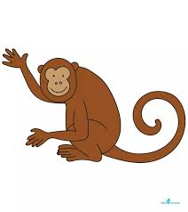
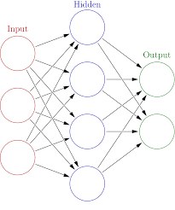
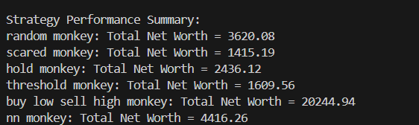
Results
80-40-20-1
No dataset was needed
Limited time to train neural network
Market simulation is likely too simple

Slide 14
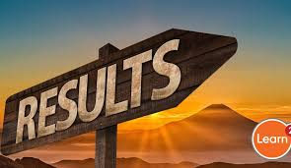
Results cont.
Limited by metrics--can’t get accuracy or ROC
Crypto bro monkey succeeded due to lack of saddle points in price history
Varying results
Dependent on number of rounds
Difficult to get consistency
Monkeys only have marginal effect on market, mostly random

Slide 15

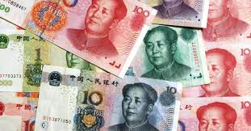

6. Conclusion & Future Work
Competitive strategies
Self generating training data
No parameters
Real world money like the chinese yuan
More competition

Slide 16
References
Rudnicky, A. (2021). The applicability of self-play algorithms to trading and forecasting financial markets. Frontiers in Artificial Intelligence, 4, Article 668465. https://doi.org/10.3389/frai.2021.668465
Kim, T., & Kang, J. M. (2017). Stock price prediction using LSTM, RNN, and CNN-sliding window model. In Proceedings of the 2017 International Conference on Research and Development in Information Retrieval (pp. 251–257). IEEE. https://doi.org/10.1109/ICSESS.2017.8126078
Silver, D., Schrittwieser, J., Simonyan, K., Antonoglou, I., Huang, A., Guez, A., ... & Hassabis, D. (2017). Mastering the game of Go without human knowledge. arXiv preprint. https://arxiv.org/pdf/1711.06583
Chong, S. Y., Tan, M. K., & White, J. D. (2005). Observing the evolution of neural networks learning to play the game of Othello. IEEE Transactions on Evolutionary Computation, 9(3), 240–251. https://doi.org/10.1109/TEVC.2005.843750

Slide 17


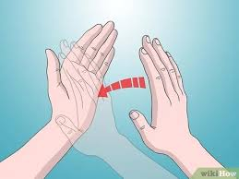

THANKS GANG <3
Pls clap

